Slide 1
Quantifying Electrostatic Fields at Protein Interfaces Using Classical Electrostatics Calculations
Andrew W. Ritchie
Adviser: Lauren J. Webb
The University of Texas at Austin
Department of Chemistry

Slide 2
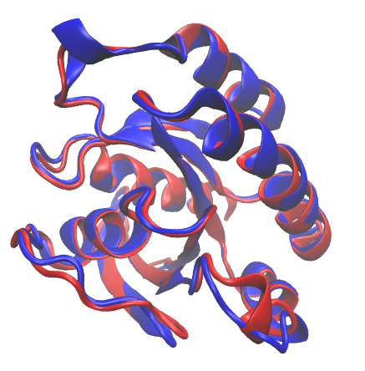
Why Study Protein Electrostatics?
50% amino acid identity
80% amino acid homology
0.7 Å effector binding surface RMSD
Ragain, et. al., J Phys. Chem. B 2012
Huang, et. al., Nat. Struct. Bio. 1998
Nassar, et. al., Nat. Struct. Bio. 1996

Slide 3
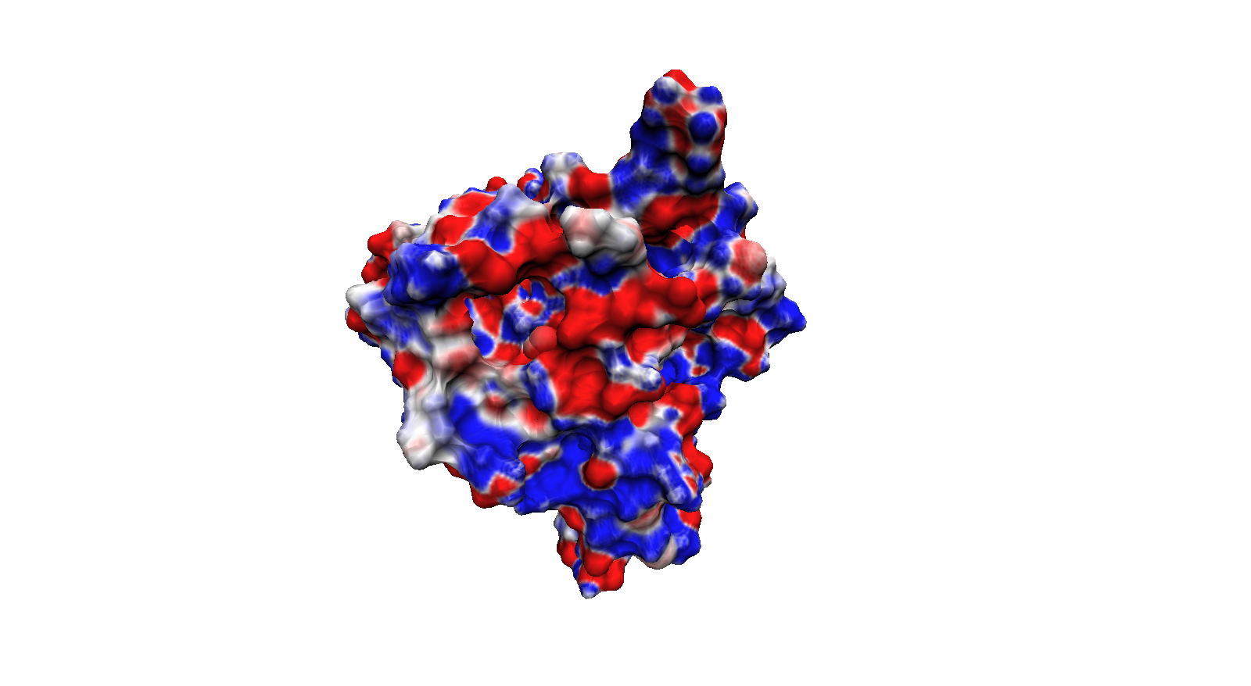
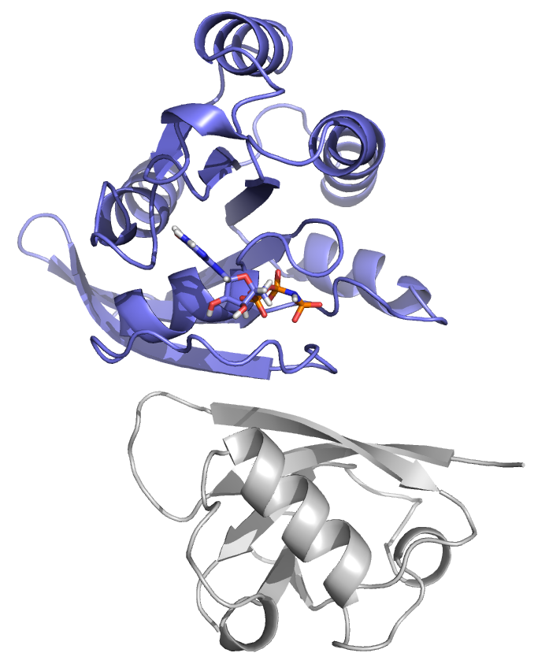
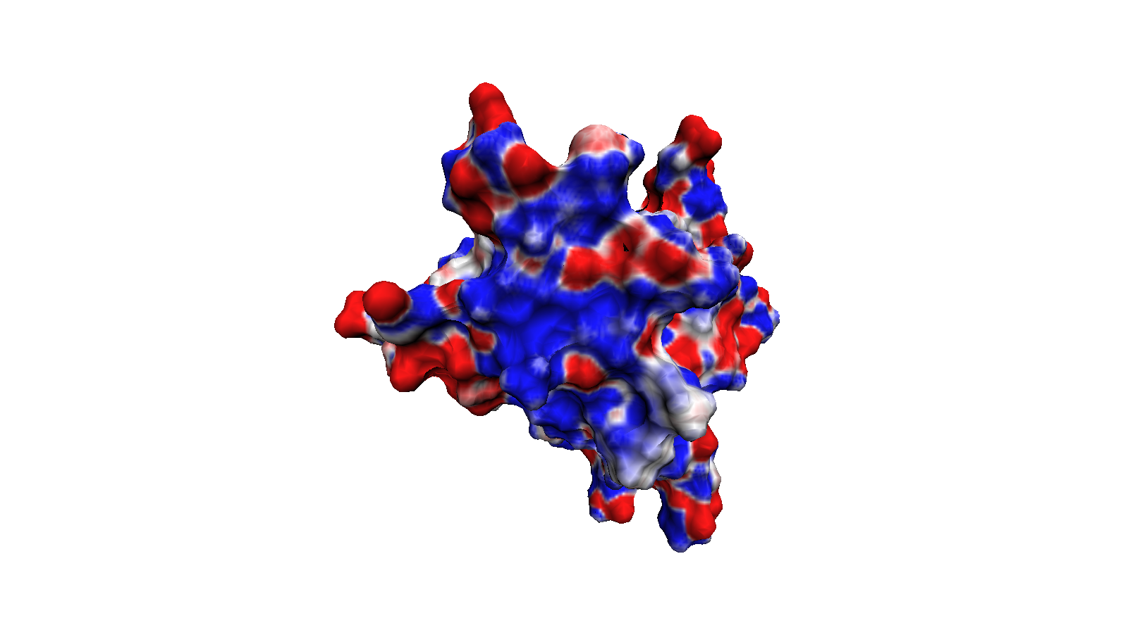
Why Study Protein Electrostatics?
≥ +25 MV/cm
≤ -25 MV/cm

Slide 4
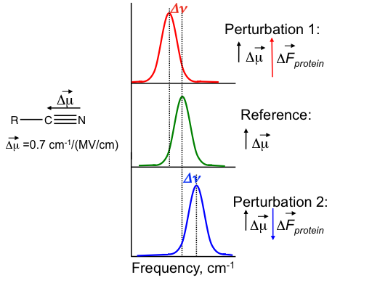
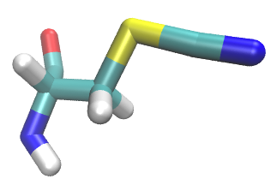
Probing Protein Electrostatics Using the Vibrational Stark Effect (VSE)

Slide 5
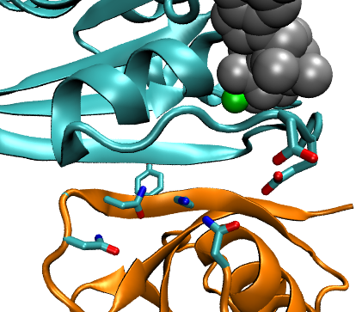
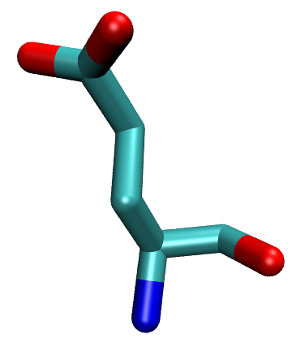
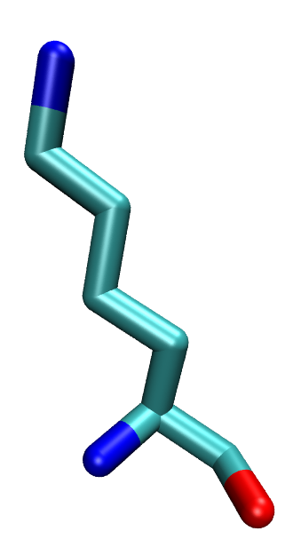
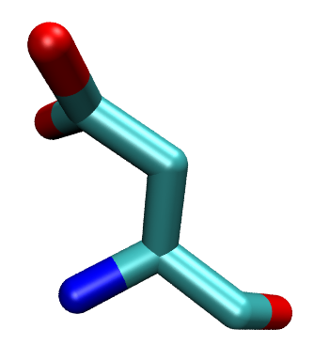
Goal: Validate Computational Electrostatic Techniques Against Experimental Stark Shifts
Rap1a
Glutamic Acid
Lysine (WT)
Position 30
E30D
Position 31
Y31
G28
K32
K31E
N29
Aspartic Acid
N54
Glutamic Acid
N27
Ralβ
Ragain, et. al., J Phys. Chem. B 2012
Notes:
I just quickly wanted to remind everyone of what I’m doing and why I’m doing it.
My group is using the vibrational Stark effect to look at the electrostatic environment at the protein protein interface. My goal is to model my group’s experimental system to allow interpretation and prediction of our experimental results. To do this I’m using molecular dynamics to generate an ensemble of protein structures on which I solve the linear poisson-boltzmann equation for and calculate a Boltzmann-weighted average field at the probe.

Slide 6
Goal: Validate Computational Electrostatic Techniques Against Experimental Stark Shifts
Ragain, et. al., J Phys. Chem. B 2012
Notes:
I just quickly wanted to remind everyone of what I’m doing and why I’m doing it.
My group is using the vibrational Stark effect to look at the electrostatic environment at the protein protein interface. My goal is to model my group’s experimental system to allow interpretation and prediction of our experimental results. To do this I’m using molecular dynamics to generate an ensemble of protein structures on which I solve the linear poisson-boltzmann equation for and calculate a Boltzmann-weighted average field at the probe.

Slide 7
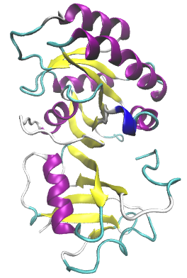
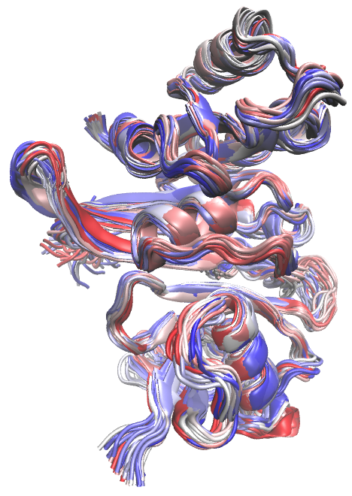
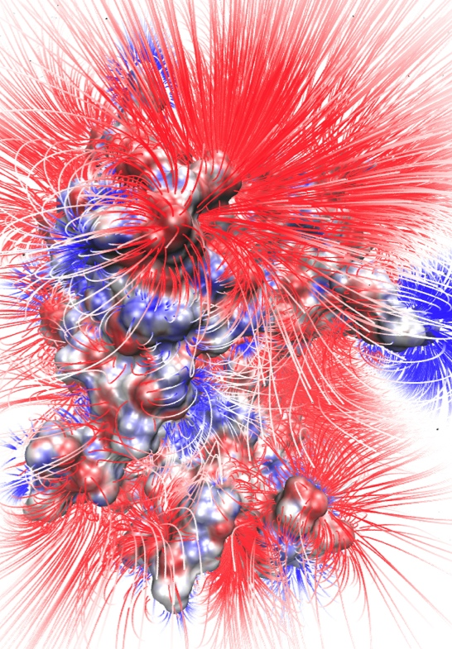
Computational Approach
PDB Structure
MD Ensemble
Electrostatic Field
Electrostatics Model
≤ -1.5
MV/cm⁻¹
T _{initial}
T _{final}
≥ +1.5
MV/cm⁻¹

Slide 8
Enhanced Molecular Dynamics: Umbrella Sampling

Slide 9
Enhanced Molecular Dynamics: Umbrella Sampling

Slide 10
Enhanced Molecular Dynamics: Umbrella Sampling

Slide 11
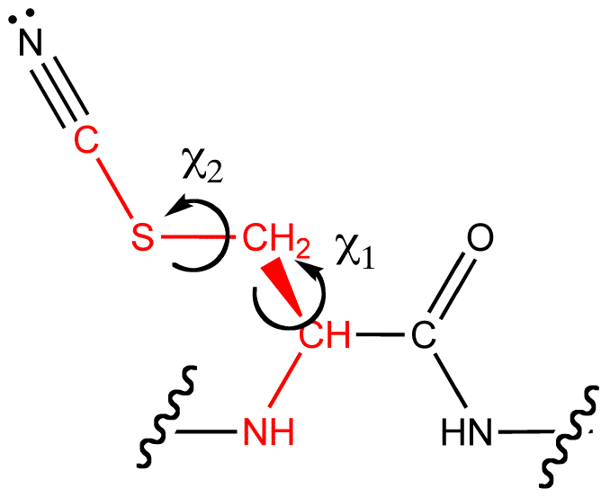
Enhanced Molecular Dynamics: Umbrella Sampling
χ₁ (Degrees)
χ₁ (Degrees)

Slide 12
2D-probability distributions: a test case
High Probability
Low Probability
Notes:
Now one of the first things I wanted to do after deciding to do a 2D sampling strategy was to make sure I knew what to expect from an alkane-like molecule and test the Weighted Histrogram Analysis code my group uses on a 2D system.
To do this I modeled a fictional molecule in which the only contribution to its energy are the chi1 and chi2 dihedral angles, which were each modeled independently using a Ryckaert-Belleman potential function. The main point I wanted to show here is that in 2 dimensions, the probability looks like the product of the 1 dimensional probabilities for an alkane molecule and that, for a perfect test case, I can reproduce the analytic probability distribution.

Slide 13
Computational Approach
PDB Structure
MD Ensemble
Electrostatic Field
Electrostatics Model
≤ -1.5
MV/cm⁻¹
T _{initial}
T _{final}
≥ +1.5
MV/cm⁻¹

Slide 14
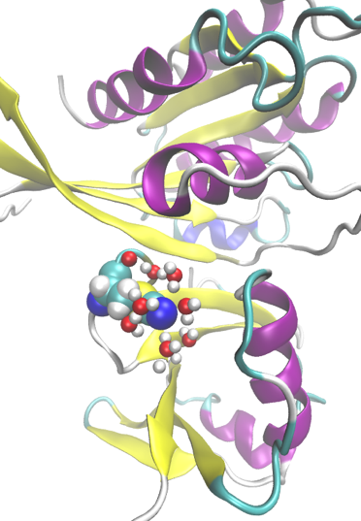
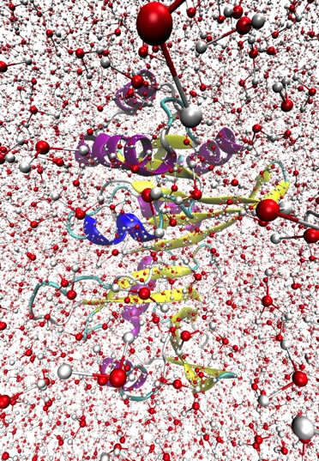
Electrostatics Models
PB Implicit Solvent | PB w/ Select Explicit Water | Explicit Solvent
AMOEBA | AMOEBA-CP | AMOEBA-CPf

Slide 15
Electrostatics Models
PB Implicit Solvent | PB w/ Select Explicit Water

Slide 16
PB: Reaction Field Method (RFM)

Slide 17
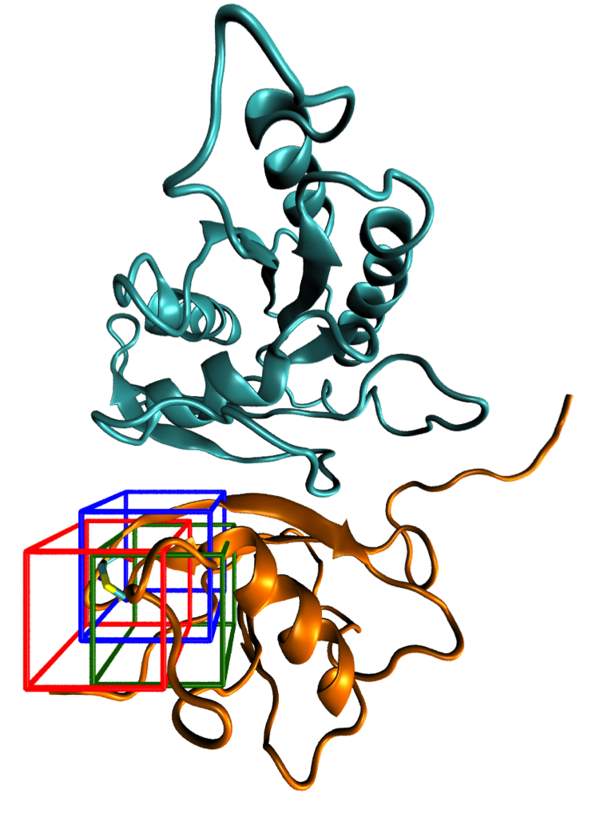
PB: Grid Location
Red: Center of nitrile Cδ
Blue: Shifted towards system center of mass
Green: Shifted towards Ralβ center of mass

Slide 18
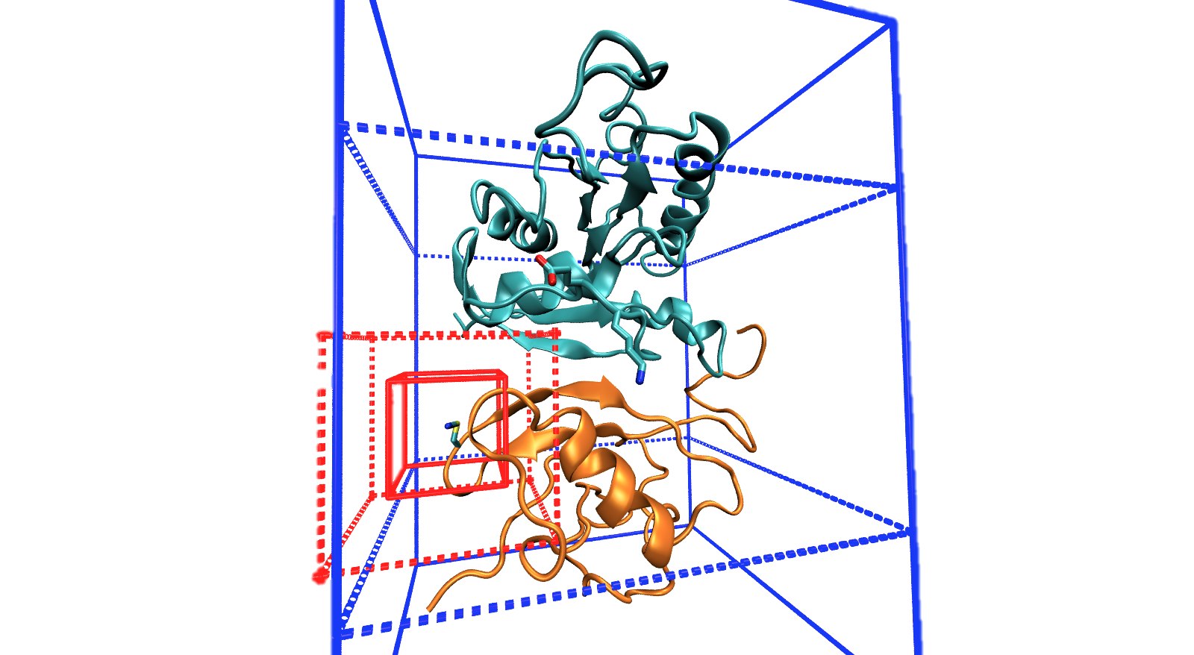
Original box
New box
Notes:
Finally, I’m also working on a set a even coarser grid-spacings in which the second stage boxes encompass approximately half and approximately all of the protein each. The idea here is to determine whether the box size or the grid spacing is more important. I do not yet have any examined data for this strategy.
Because APBS is very highly tunable, one of the challenges is determining which parameters are most important and whether or not it’s physically reasonable. Right now, focusing on the box positions, I’m trying to come up with a consistent metric for determining how to decide the location, size, and grid spacing that is the most useful combination of accurate and quick.

Slide 21
Conclusions
Fields calculated via PB are sensitive to the grid location, even for calculating the field at a single point in space
The larger box is more insensitive to grid location
The RFM is more insensitive to grid location
The difference calculation systematically improves correlations with experiment for the purely numeric PB solution and not for the RFM. Possible that a nonphysical error is cancelled out by taking a difference calculation, which is reintroduced via the RFM

Slide 22
PB: Including Selected TIP3P Water Molecules

Slide 23
PB: Including Selected TIP3P Water Molecules
9.92%
20 +- 4.2

Slide 24
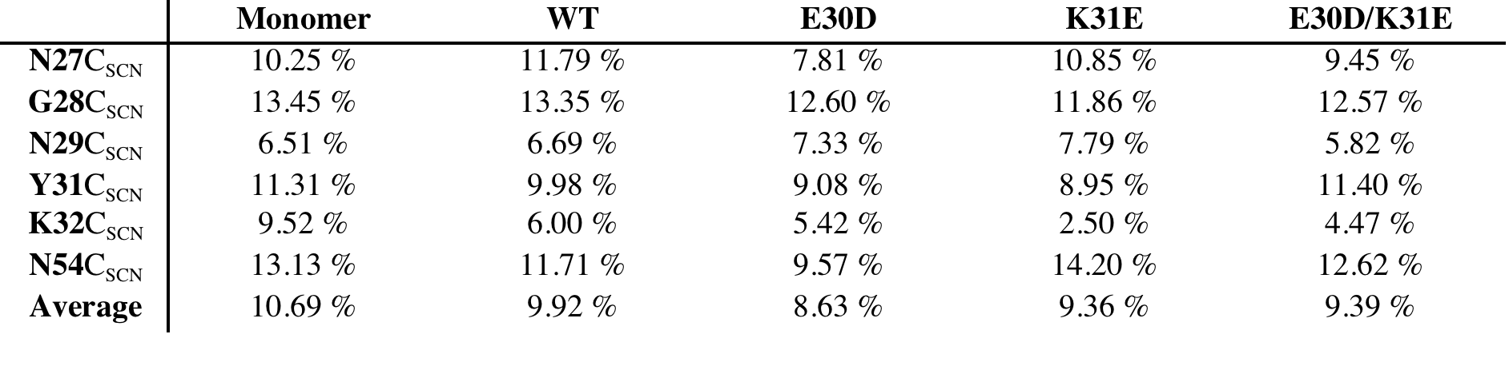
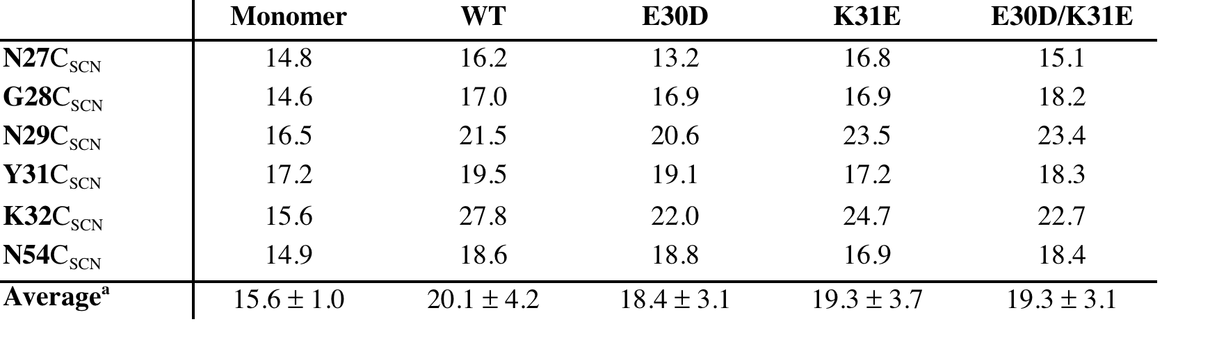
PB: Including Selected TIP3P Water Molecules
Percentage of Frames with a Nitrile-Water Hydrogen Bond
Average Number of Frames Water Remained within 5 Å of Nitrile

Slide 25
PB: Including Selected TIP3P Water Molecules

Slide 26
Electrostatic Frame Clustering: Taking advantage of a weighted average

Slide 27
Electrostatic Frame Clustering: Taking advantage of a weighted average

Slide 28
Calculating Fields in AMOEBA

Slide 30
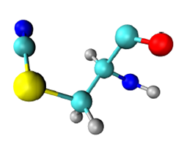
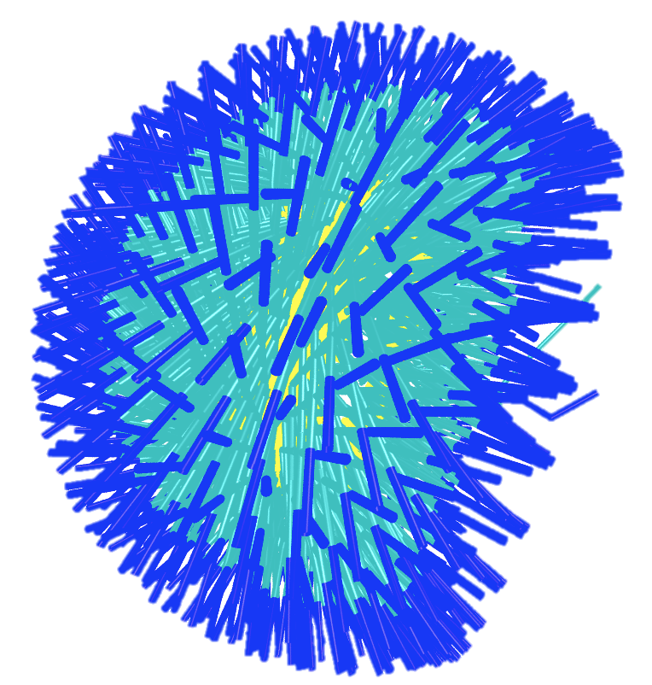
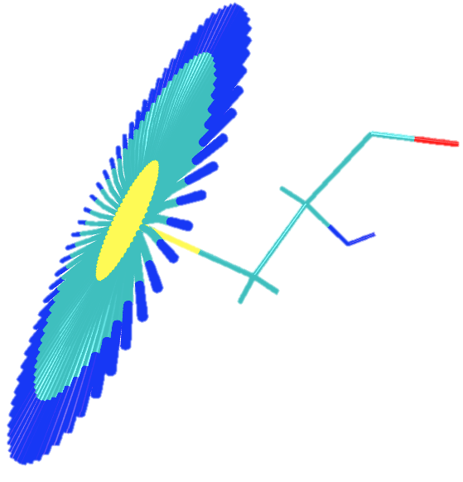
MD: sampling methods
Old (1D)
χ₁
18 ns
New (2D)
χ₁ + χ₂
57.6 ns
Cδ
Cα
Sγ
N
Cβ
χ₁
χ₂
Notes:
The most impactful difference between sampling two degrees of freedom rather than one are the dipole moment vectors of the nitrile probe. The reason for using umbrella sampling is because there are potential energy barriers that are not likely to be surpassed over a reasonable simulation time at biologically relevant temperatures. The nitrile probe used has two relevant torsional degrees of freedom beyond the backbone. By just biasing a single degree of freedom, chi 2, an ensemble of structures are generated which nearly all have the same chi 1 dihedral and incompletely samples the 3 dimensional dipole vector space.
Using 2D umbrella sampling, however, creates a more-complete picture of probe dipole vectors, which is relevant for the magnitude of the VSE.

Slide 31
Conclusions
Notes:
In conclusion, with reasonable parameters, the point charge APBS model is somewhat predictive of the experimentally seen frequencies. However, this is sensitive to both the box positions as well as the dielectric chosen. For the box position, I’m working on determining what makes a consistently “best” box position independent of probe location. For the dielectric, I’m working on eliminating that as a relevant parameter by explicitly modeling polarizability with Dr. Ren and Dr. Schnieders.
Finally, I do plan to move on to explicit solvent electrostatics calculations once I’ve fully investigated the current implicit solvent systems.

Slide 32
Acknowledgements
Advisor
Lauren Webb
Postdocs
Daniel Ensign
Annette Raigoza
Graduate Students
Jason Dugger
Wenhui Hu
Christina Ragain
Kjell Schroder
Rebika Shrestha
Amy Stafford
David Walker
Undergraduates
Nancy Gonzalez
Kristina
Facilities
TI3D
TACC
Funding
Burroughs Wellcome Fund
The Welch Foundation
The University of Texas at Austin
Collaborators
Pengyu Ren (Biomedical Engineering)
Michael Schnieders (Iowa)

Slide 34
2D-WHAM
Convert 2D-problem to 1D-problem
Bin(0,0)=0, Bin(0,1)=1, …
For 72x72 5º bins, 5184 total bins
Convert 1D python script to C++
Bug found! Fix and test against known potential
Ryckaert-Bell alkane potential:
C_{n}={9.28, 12.16, -13.12, -3.06, 26.24, -31.5}

Slide 35
Stark turning rate and dielectric constant
Stark effect
Linear PBE

